Slide 1

Presentado por:
Víctor Martínez vmartinez@reactos.org
Michele C. hackbunny@reactos.org
Javier Fernández

Slide 2
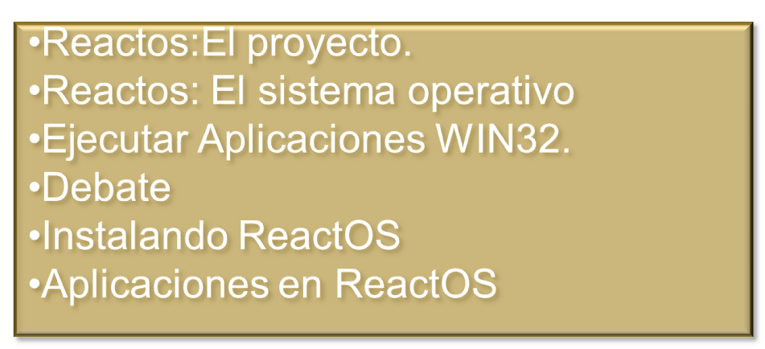
ReactOS. Introducción
Reactos:El proyecto.
Reactos: El sistema operativo
Ejecutar Aplicaciones WIN32.
Debate
Instalando ReactOS
Aplicaciones en ReactOS
ReactOS. Internals
Notes:
Intro: 30 seconds

Slide 3

ReactOS. El proyecto
Objetivo del Proyecto.
ReactOS es un proyecto open-source cuyo objetivo es crear un Sistema Operativo que permita la instalación de Drivers y la ejecución de Aplicaciones diseñadas para Windows
Notes:
ReactOS is a Project and an OS. ReactOS as a Project now.

Slide 4
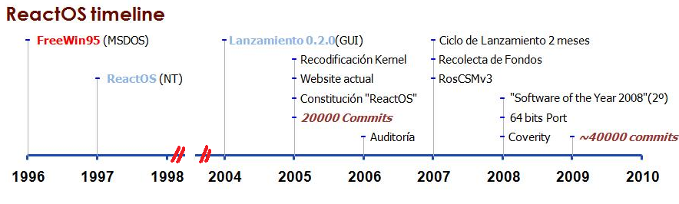
ReactOS. El Proyecto
TimeLine.
Notes:
ReactOS timeline: Focusing in the Recent days and the Origin.
-Remark the Commits: reaching 20000 commits after 9 years, and 20k-40k in just 4
-Auditory: As a Legal issue to find Company support.Companies just support Legal Code.As ours.

Slide 5
ReactOS. El Proyecto
La Fundación ReactOS.
Entidad Logística y Administrativa, sin ánimo de lucro, reguladora de los recursos del proyecto.
ADMINISTRACIÓN
Rusia
RAMAS
Alemania
Notes:
ReactOs as a project is supported by the ReactOS Foundation.
-ReactOS foundation objetives
-ReactOS branch. Why the branch is created?

Slide 6
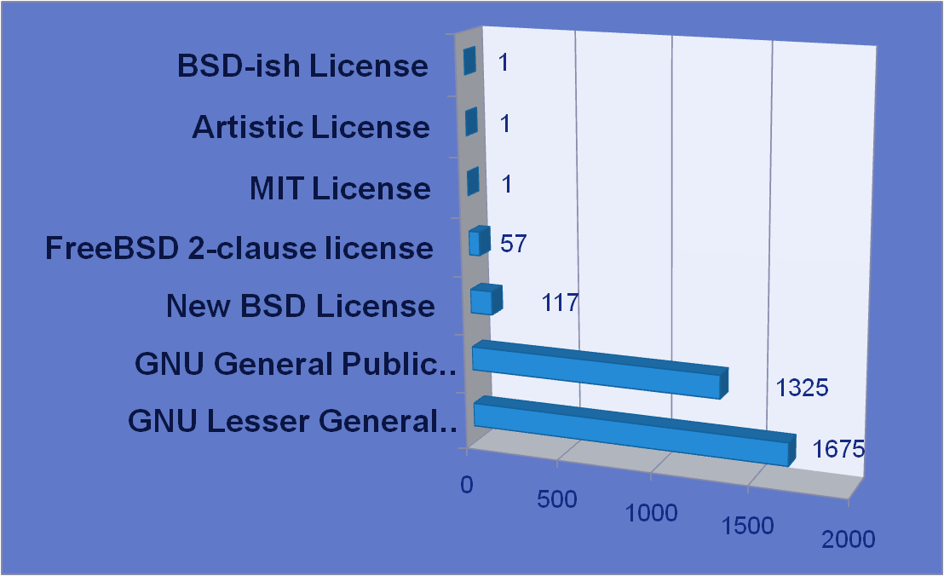
ReactOS. El Proyecto
Tipo de Licencias en el Proyecto.
Notes:
-Licenses inside our project.

Slide 7
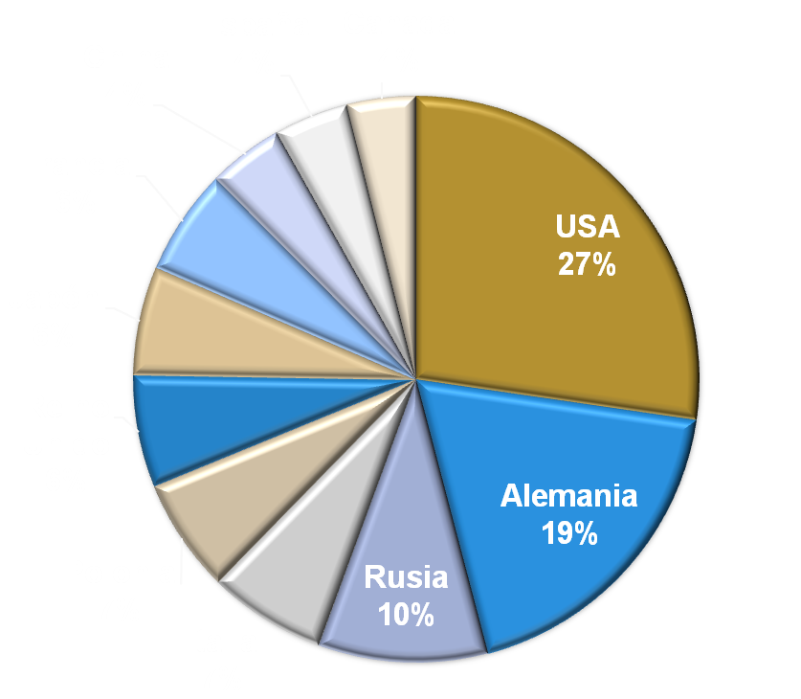
ReactOS. El Proyecto
Usuarios Website 2008
Notes:
-Users of our Website.
-Remark Germany against USA. Germany is a lot smaller but has almost same users than USA.

Slide 8
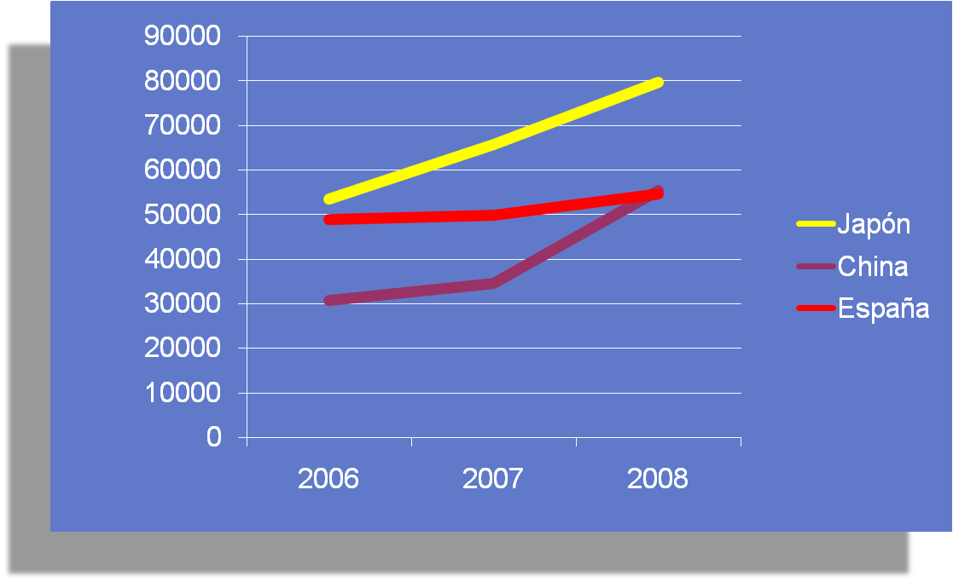
ReactOS.El proyecto
Usuarios Websites: España,China,Japón.
Notes:
-Users Evolution:
-Spain graphic because the talk is in Spain
-Japan and China because they are becoming users so fast.Maybe the Linux Unified Kernel?

Slide 9
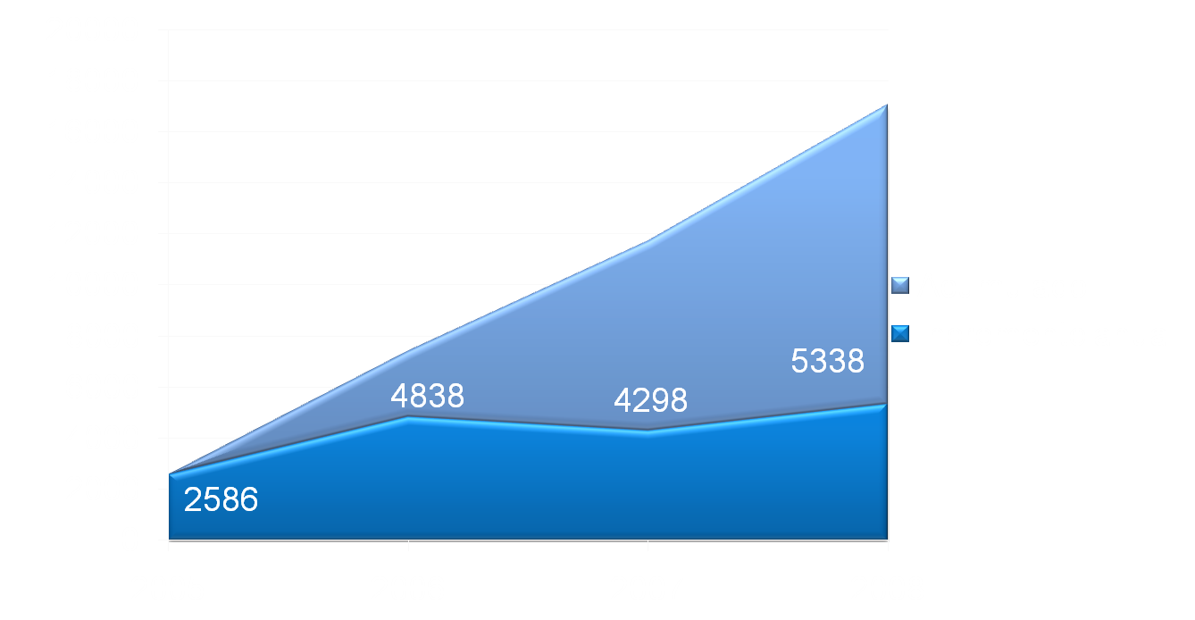
ReactOS.El proyecto
Miembros de la Comunidad.
Notes:
-Community Members(Registered):
-Each year we are increasing the number.That means we are spreading.

Slide 10
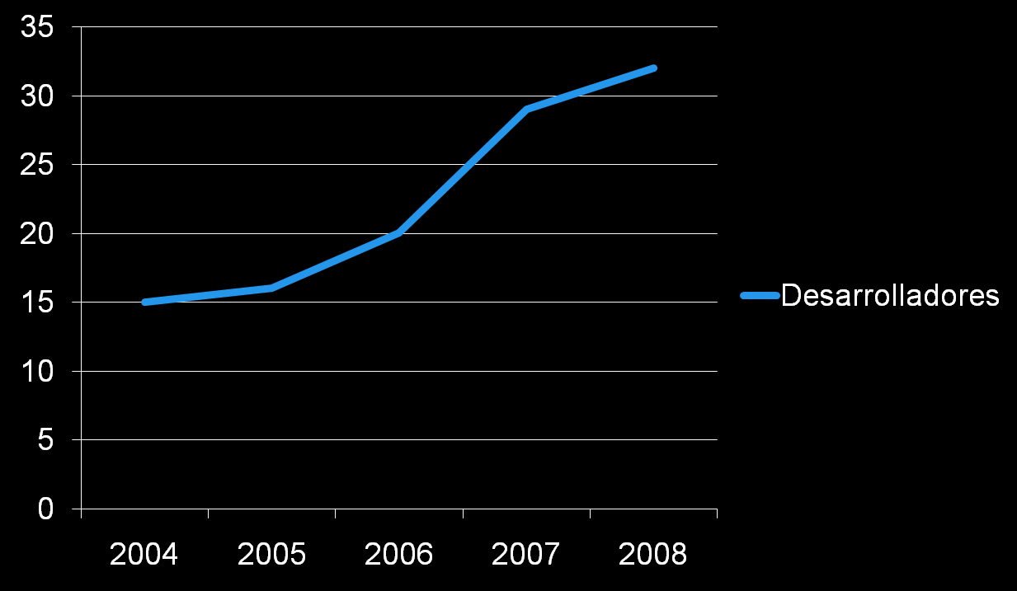
ReactOS.El Proyecto
Notes:
-Developers are joining ReactOS project...but there arent enough.Always new Devs are wellcome.

Slide 11
ReactOS. El Sistema Operativo
El Sistema Operativo.
ReactOS es un Sistema Operativo Open –Source, que permite la instalación de Drivers y la ejecución de Aplicaciones Win32 bajo una Arquitectura NT.
Notes:
ReactOS as an Operating System.

Slide 12
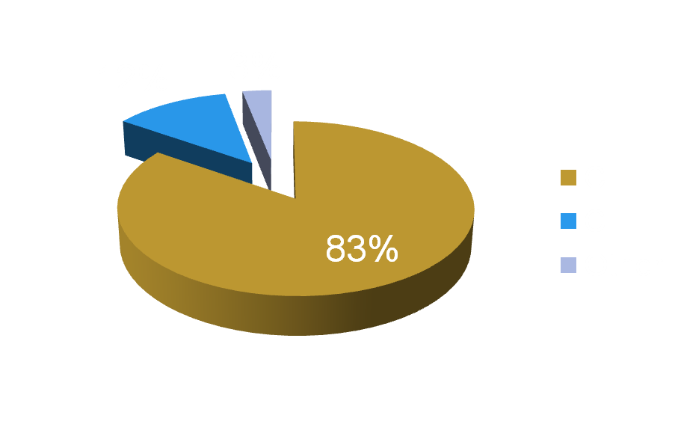
ReactOS. El Sistema Operativo
El Sistema Operativo: Código Fuente
Notes:
-Language used to code reactOS

Slide 13

ReactOS. El Sistema Operativo
Descargas ISO de ReactOS.
Notes:
-ISO downloads.
Real Statistics: 0.3.5, 0.3.6,0.3.7
Extrapolated: 0.3.8->With a Linear: ~70000, with a Logarithmic: ~63000

Slide 14
ReactOS. El Sistema Operativo
Ejecutar Aplicaciones WIN32.
LINUX+WINE
ReactOS
LINUX UNIFIED
KERNEL
Notes:
Different Ways of executing WIn32 Apps.
-Remark:
Linux+Wine are more compatible than us thanks to Linux Kernel Stability.
But these Kernel will tie its compatibility in a future.
ReactOS is winning compatibility so fast, and because we use a NT architecture we wont have any limit compatibility.
-Remark:
Anyways Linux+Wine doesnt accept Windows Drivers.
-Remark:
Linux Unified Kernel uses ReactOS code, so they are steps behind us.

Slide 15

ReactOS. El Sistema Operativo
LINUX+WINE y ReactOS
  Aplicaciones WIN32
  WINE
ReactOS
LINUX

Slide 16
ReactOS. El Sistema Operativo
Debates:
  ¿Comunidad de Software Libre gracias a ReactOS?
  ¿Apoyo Real de Compañías al Software Libre?
  ¿”Competencia” en el Software Libre?
  ReactOS:¿Un puente necesario entre Windows y Linux?
Notes:
-Is ReactOS promoting a new Open Source Community around win32 APPs?(Paint.exe, calc.exe clones)
-3 mainly reasons why Companies dont jump to Open Source OS(Linux mainly):
GUI, Drivers, APPS. ReactOS fixes this, are the companies going to “jump” to ReactOS?
Why any Companies are still supporting this project?
Is the “I support Open Source” a Companies Market Slogan but not a real one?
-This OS is getting bigger and more noticeable, nowadays few OpenSource OS are good Linux Competitor...so until now there isnt any kind of “competence”. Is ReactOS going to create “competence” against Linux?Or is ReactOS perfectly compatible with Linux?
ReactOS is set between Windows and Linux:
Shares with Windows: GUI,APP,DRIVERS:Comfort.
Shares with GNU-Linux: Open Source Community.
Is ReactOS going to be the bridge to let Windows users jump to Linux?

Slide 17
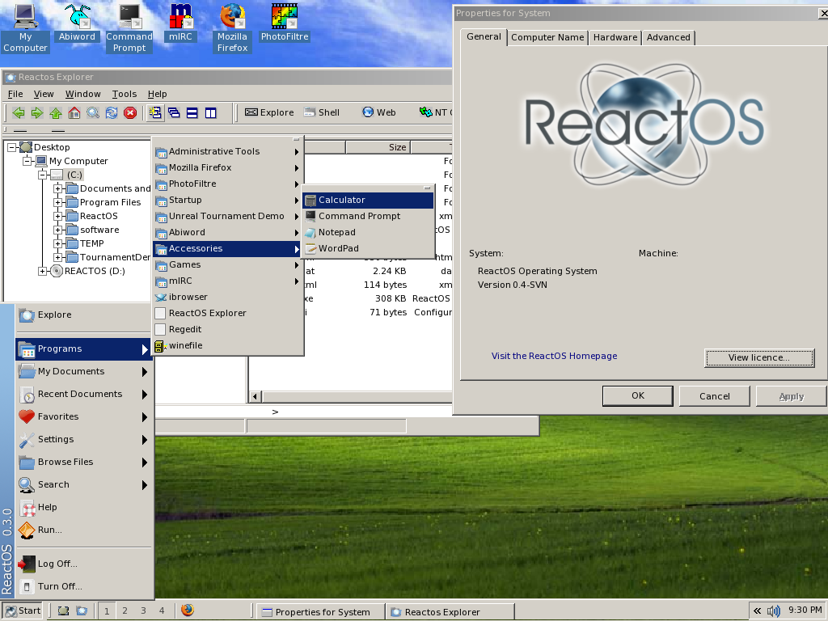
Interfaz de ReactOS
Notes:
Remark the GUI.Equal to Windows GUI.

Slide 18
¿Cuestiones?
Demostración
Notes:
Question time!
A demonstration of ReactOS!

